Slide 1


Soliman zakria
11-jan-2023

Slide 2
Outline
Executive Summary
Introduction
Methodology
Results
Conclusion
Appendix

Slide 3
Executive Summary
Summary of methodologies
Data Collection through API
Data Collection with Web Scraping
Data Wrangling
Exploratory Data Analysis with SQL
Exploratory Data Analysis with Data Visualization
Interactive Visual Analytics with Folium
Machine Learning Prediction
Summary of all results
Exploratory Data Analysis result
Interactive analytics in screenshots
Predictive Analytics result from Machine Learning Lab

Slide 4
Introduction
SpaceX is a revolutionary company who has disrupt the space industry by offering a rocket launches specifically Falcon 9 as low as 62 million dollars; while other providers cost upward of 165 million dollar each. Most of this saving thanks to SpaceX astounding idea to reuse the first stage of the launch by re-land the rocket to be used on the next mission. Repeating this process will make the price down even further. As a data scientist of a startup rivaling SpaceX, the goal of this project is to create the machine learning pipeline to predict the landing outcome of the first stage in the future. This project is crucial in identifying the right price to bid against SpaceX for a rocket launch.
The problems included:
Identifying all factors that influence the landing outcome.
The relationship between each variables and how it is affecting the outcome.
The best condition needed to increase the probability of successful landing.
4

Slide 5

Section 1
5

Slide 6
Methodology
Executive Summary
Data collection methodology:
Data was collected using SpaceX REST API and web scrapping from Wikipedia
Perform data wrangling
Data was processed using one-hot encoding for categorical features
Perform exploratory data analysis (EDA) using visualization and SQL
Perform interactive visual analytics using Folium and Plotly Dash
Perform predictive analysis using classification models
How to build, tune, evaluate classification models

Slide 7
Data Collection
Data collection is the process of gathering and measuring information on targeted variables in an established system, which then enables one to answer relevant questions and evaluate outcomes. As mentioned, the dataset was collected by REST API and Web Scrapping from Wikipedia
For REST API, its started by using the get request. Then, we decoded the response content as Json and turn it into a pandas dataframe using json_normalize(). We then cleaned the data, checked for missing values and fill with whatever needed.
For web scrapping, we will use the BeautifulSoup to extract the launch records as HTML table, parse the table and convert it to a pandas dataframe for further analysis

Slide 8


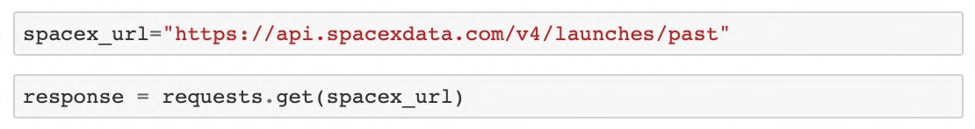

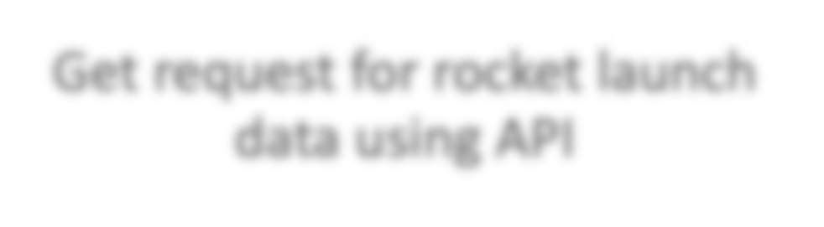


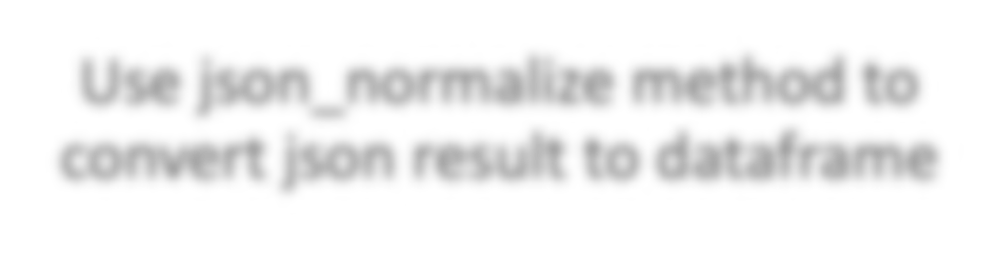


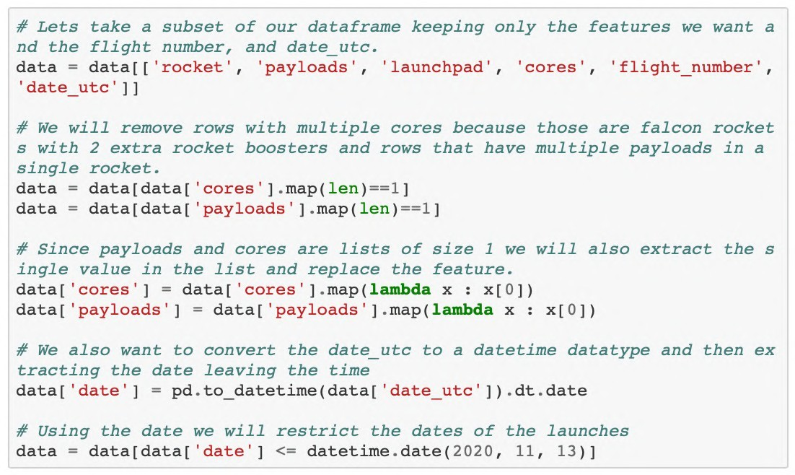


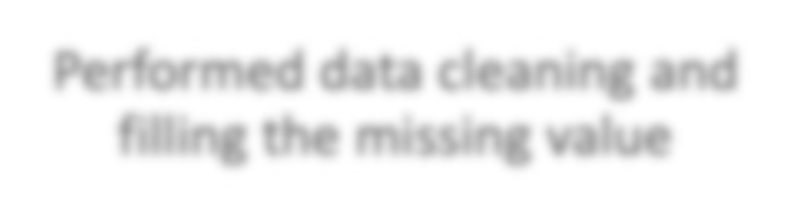
Data Collection – SpaceX API
Get request for rocket launch data using API
Use json_normalize method to convert json result to dataframe
Performed data cleaning and filling the missing value
From: https://github.com/farishelmi17/SpaceX/blob/m ain/notebook:Data_Collection_yJPxhv2oU.ipynb
8

Slide 9



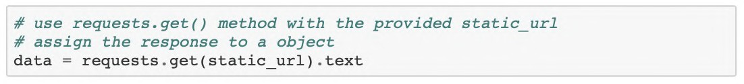




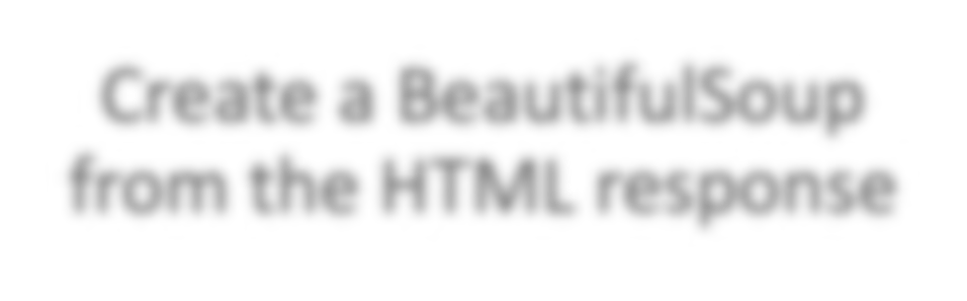
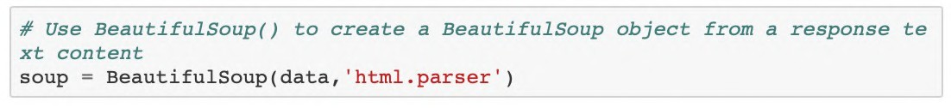


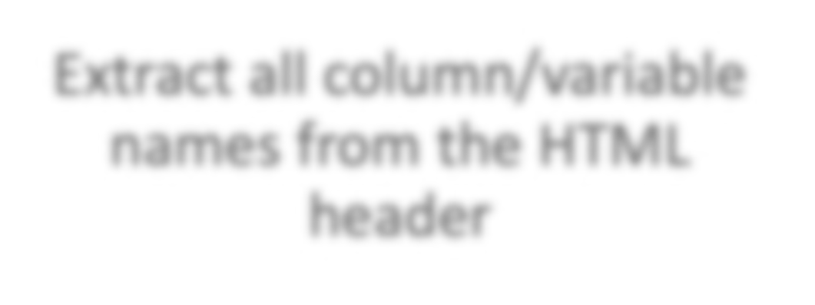

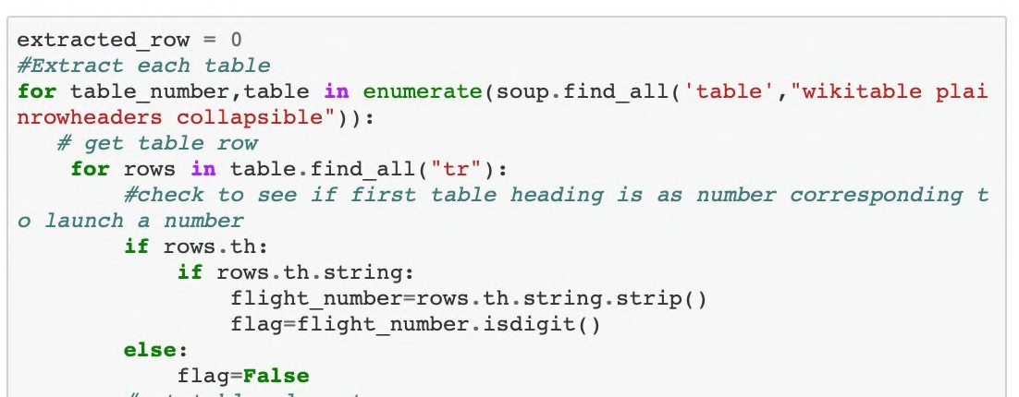
Data Collection - Scraping
Request the Falcon9 Launch Wiki page from url
Create a BeautifulSoup from the HTML response
Extract all column/variable names from the HTML header
From: https://github.com/farishelmi17/SpaceX/blo b/main/notebook:Data_Collection_with_We b_Scraping_nI89VIRCE.ipynb
9

Slide 10


Data Wrangling
Data Wrangling is the process of cleaning and unifying messy and complex data sets for easy access and Exploratory Data Analysis (EDA).
We will first calculate the number of launches on each site, then calculate the number and occurrence of mission outcome per orbit type.
We then create a landing outcome label from the outcome column. This will make it easier for further analysis, visualization, and ML. Lastly, we will export the result to a CSV.
From: https://github.com/farishelmi17/SpaceX/blob/main/noteboo k:Data_Wrangling_9HnvfsJ5G.ipynb

Slide 11

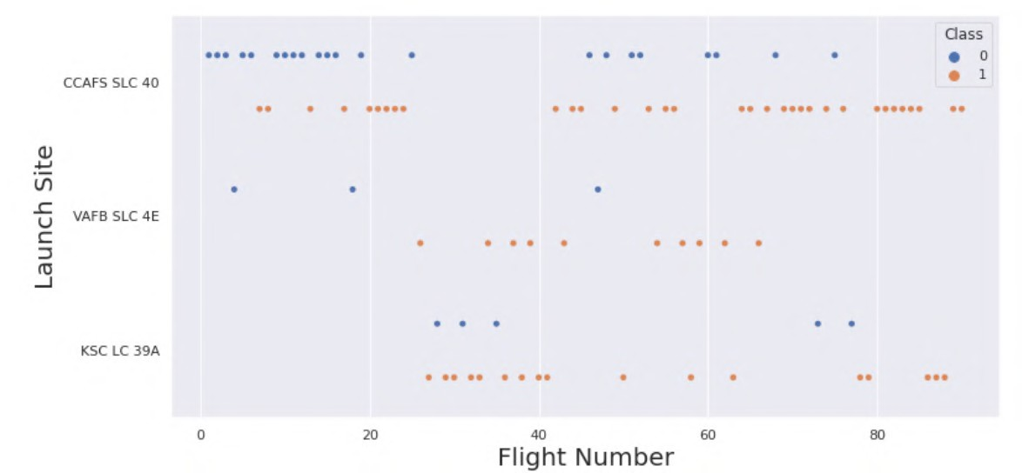

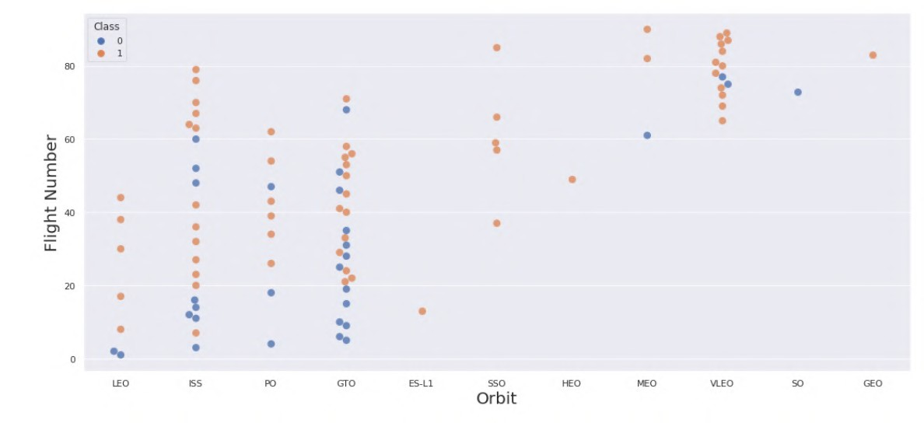
EDA with Data Visualization
We first started by using scatter graph to find the relationship between the attributes such as between:
Payload and Flight Number.
Flight Number and Launch Site.
Payload and Launch Site.
Flight Number and Orbit Type.
Payload and Orbit Type.
Scatter plots show dependency of attributes on each other. Once a pattern is determined from the graphs. It’s very easy to see which factors affecting the most to the success of the landing outcomes.
ttps://github.com/farishelmi17/SpaceX/blob/main/notebook:Exploratory_Data_A nalysis_with_Visualisation_Lab_jJkKVG6F1.ipynb

Slide 12

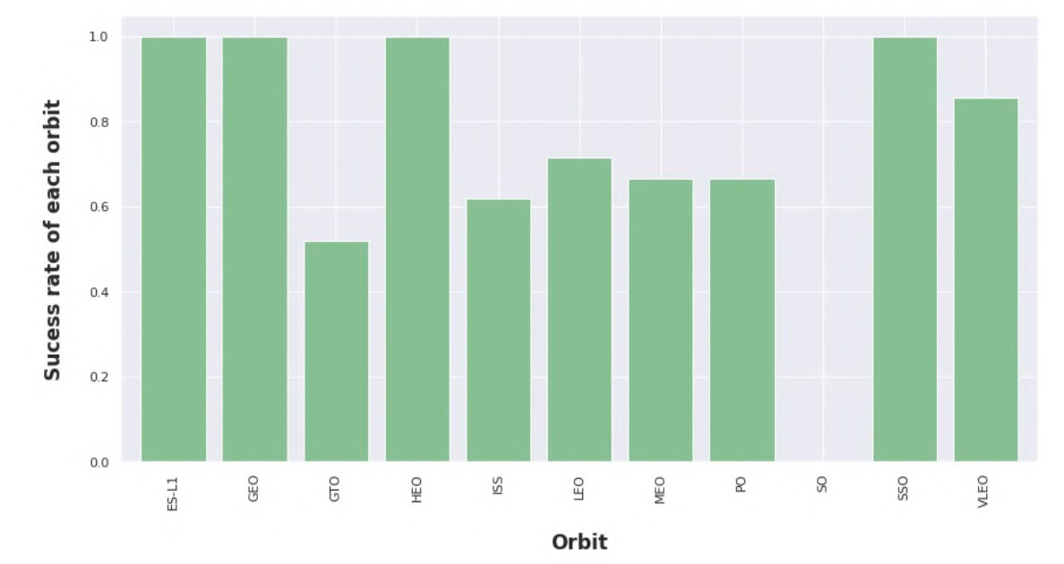

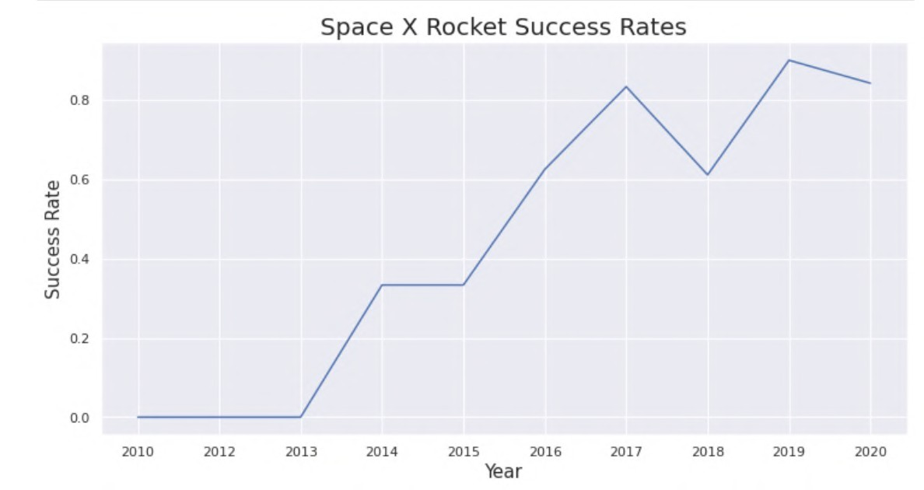
EDA with Data Visualization
Once we get a hint of the relationships using scatter plot. We will then use further visualization tools such as bar graph and line plots graph for further analysis.
Bar graphs is one of the easiest way to interpret the relationship between the attributes. In this case, we will use the bar graph to determine which orbits have the highest probability of success.
We then use the line graph to show a trends or pattern of the attribute over time which in this case, is used for see the launch success yearly trend.
We then use Feature Engineering to be used in success prediction in the future module by created the dummy variables to categorical columns.
ttps://github.com/farishelmi17/SpaceX/blob/main/notebook:Exploratory_Data_Analysis_with
_Visualisation_Lab_jJkKVG6F1.ipynb

Slide 13
EDA with SQL
Using SQL, we had performed many queries to get better understanding of the dataset, Ex:
Displaying the names of the launch sites.
Displaying 5 records where launch sites begin with the string ‘CCA’.
Displaying the total payload mass carried by booster launched by NASA (CRS).
Displaying the average payload mass carried by booster version F9 v1.1.
Listing the date when the first successful landing outcome in ground pad was achieved.
Listing the names of the boosters which have success in drone ship and have payload mass greater than 4000 but less than 6000.
Listing the total number of successful and failure mission outcomes.
Listing the names of the booster_versions which have carried the maximum payload mass.
Listing the failed landing_outcomes in drone ship, their booster versions, and launch sites names for in year 2015.
Rank the count of landing outcomes or success between the date 2010-06-04 and 2017-03-20, in descending order.
https://github.com/farishelmi17/SpaceX/blob/main/notebook:Exploratory_Data_Analysis_with_SQL eqznon1EA.ipynb
13

Slide 14
Build an Interactive Map with Folium
To visualize the launch data into an interactive map. We took the latitude and longitude coordinates at each launch site and added a circle marker around each launch site with a label of the name of the launch site.
We then assigned the dataframe launch_outcomes(failure,success) to classes 0 and 1 with Red and Green markers on the map in MarkerCluster().
We then used the Haversine’s formula to calculated the distance of the launch sites to various landmark to find answer to the questions of:
How close the launch sites with railways, highways and coastlines?
How close the launch sites with nearby cities?
From: https://github.com/farishelmi17/SpaceX/blob/main/notebook:Interactive_Visual_Analytics_with_Folium_M8uUhCmHY.ipynb
14

Slide 15
Build a Dashboard with Plotly Dash
We built an interactive dashboard with Plotly dash which allowing the user to play around with the data as they need.
We plotted pie charts showing the total launches by a certain sites.
We then plotted scatter graph showing the relationship with Outcome and Payload Mass (Kg) for the different booster version.
The link of the app.py:: https://github.com/farishelmi17/SpaceX/blob/main/spacex_dash_app.py

Slide 16




Predictive Analysis (Classification)
Building the Model
Load the dataset into NumPy and Pandas
Transform the data and then split into training and test datasets
Decide which type of ML to use
set the parameters and algorithms to GridSearchCV and fit it to dataset.
Evaluating the Model
Check the accuracy for each model
Get tuned hyperparameters for each type of algorithms.
plot the confusion matrix.
Improving the Model
Use Feature Engineering and Algorithm Tuning
Find the Best Model
The model with the best accuracy score will be the best performing model.
From: https://github.com/farishelmi17
/SpaceX/blob/main/spacex_das h_app.py

Slide 17
Results
The results will be categorized to 3 main results which is:
Exploratory data analysis results
Interactive analytics demo in screenshots
Predictive analysis results

Slide 18

Section 2

Slide 19

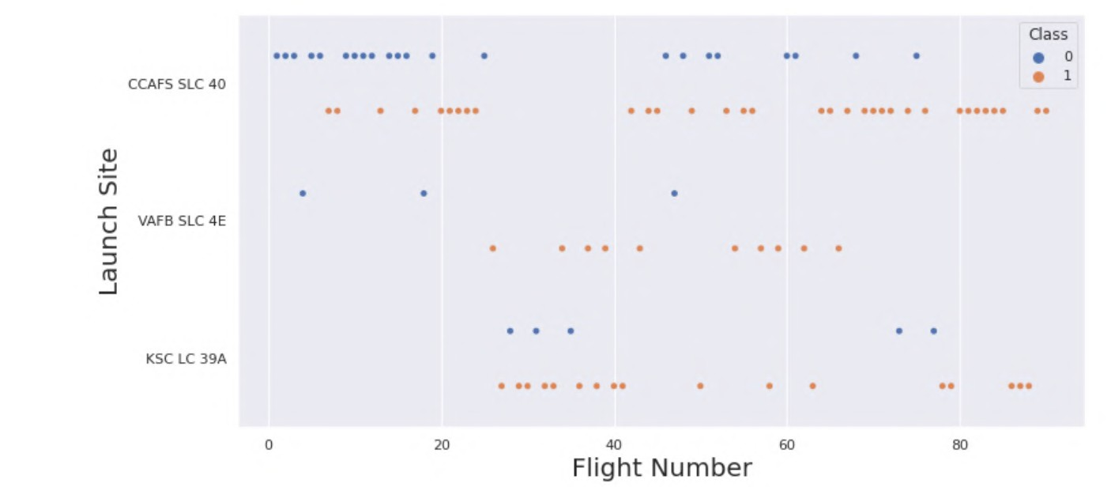
Flight Number vs. Launch Site
This scatter plot shows that the larger the flights amount of the launch site, the greater the the success rate will be.
However, site CCAFS SLC40 shows the least pattern of this.

Slide 20

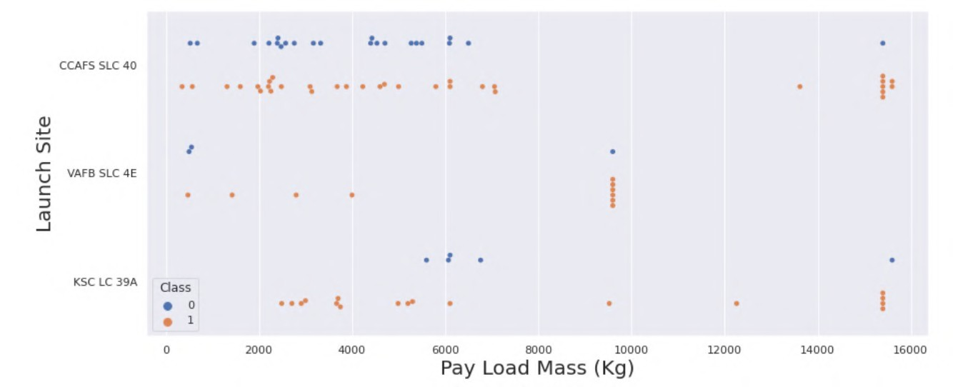
Payload vs. Launch Site
This scatter plot shows once the pay load mass is greater than 7000kg, the probability of the success
rate will be highly
increased.
However, there is no clear pattern to say the launch site is dependent to the pay load mass for the success
rate.

Slide 21

Success Rate vs. Orbit Type
This figure depicted the possibility of the orbits to influences the landing outcomes as some orbits has 100% success rate such as SSO, HEO, GEO AND ES-L1 while SO orbit produced 0% rate of success.
However, deeper analysis show that some of this orbits has only 1 occurrence such as GEO, SO, HEO and ES-L1 which mean this data need more dataset to see pattern or trend before we draw any conclusion.

Slide 22

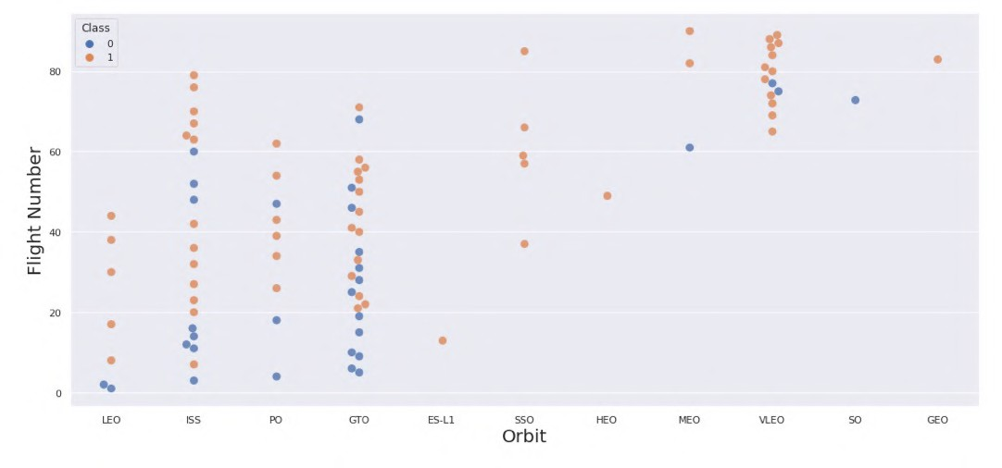
Flight Number vs. Orbit Type
This scatter plot shows that generally, the larger the flight number on each orbits, the greater the success rate (especially LEO orbit) except for GTO orbit which depicts no relationship between both
attributes.
Orbit that only has 1 occurrence should also be excluded from above statement as it’s needed
more dataset.

Slide 23

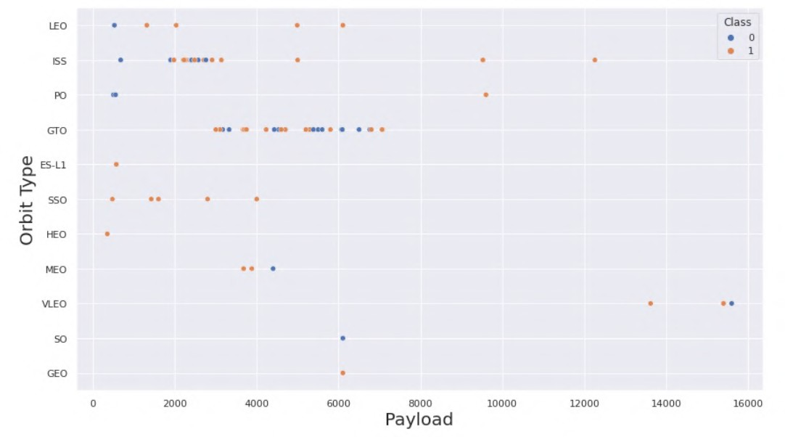
Payload vs. Orbit Type
Heavier payload has positive impact on LEO, ISS and P0 orbit. However, it has negative impact on MEO and VLEO orbit.
GTO orbit seem to depict no relation between the attributes.
Meanwhile, again, SO, GEO and HEO orbit need more dataset to see any pattern or trend.

Slide 24

Launch Success Yearly Trend
This figures clearly depicted and increasing trend from the year 2013 until 2020.
If this trend continue for the next year onward. The success rate will steadily increase until reaching 1/100% success rate.
.
• JDJD

Slide 25

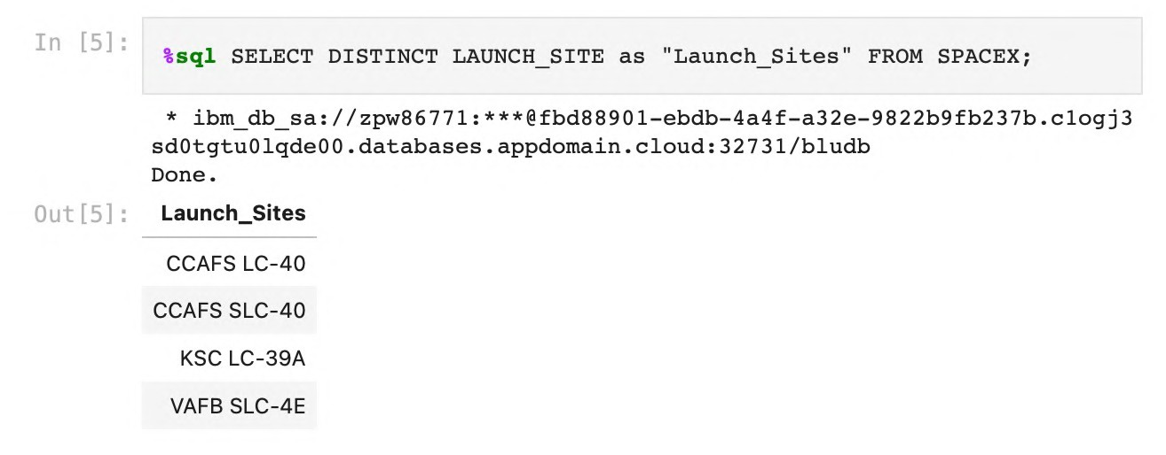
All Launch Site Names
We used the key word DISTINCT to show only unique launch sites from the SpaceX data.

Slide 26

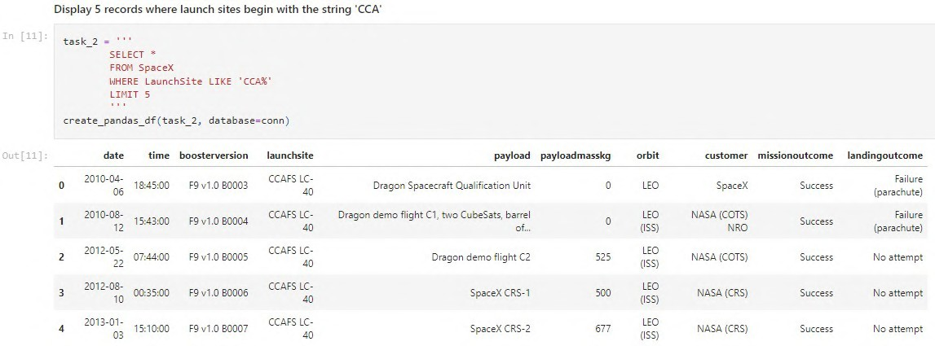
Launch Site Names Begin with 'CCA'
We used the query above to display 5 records where launch sites begin with `CCA`

Slide 27

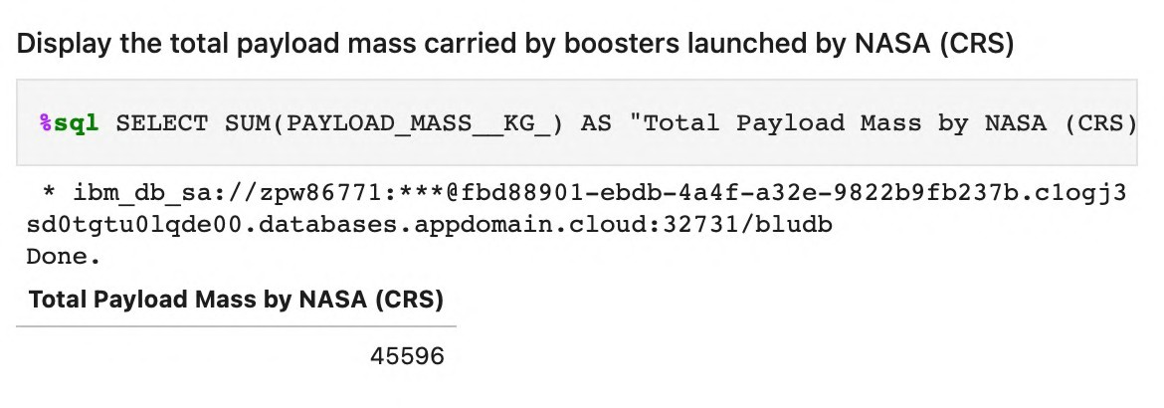
Total Payload Mass
We calculated the total payload carried by boosters from NASA as 45596 using the query below

Slide 28

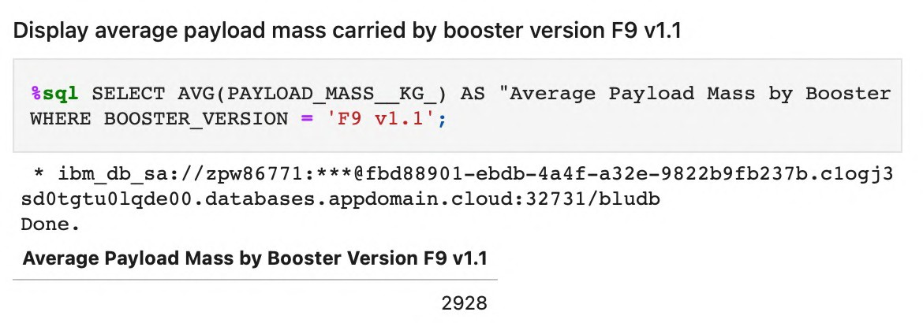
Average Payload Mass by F9 v1.1
We calculated the average payload mass carried by booster version F9 v1.1 as 2928.4

Slide 29

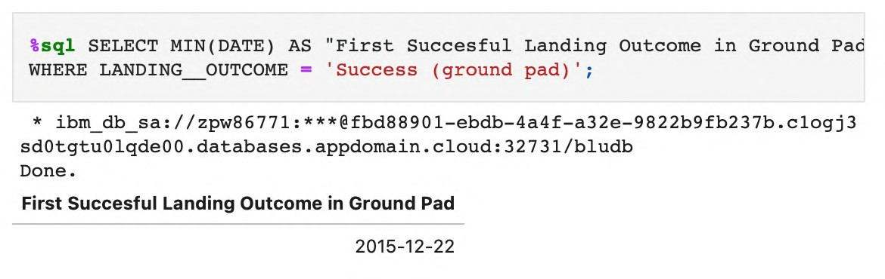
First Successful Ground Landing Date
We use the min() function to find the result
We observed that the dates of the first successful landing outcome on ground pad was 22nd December 2015

Slide 30

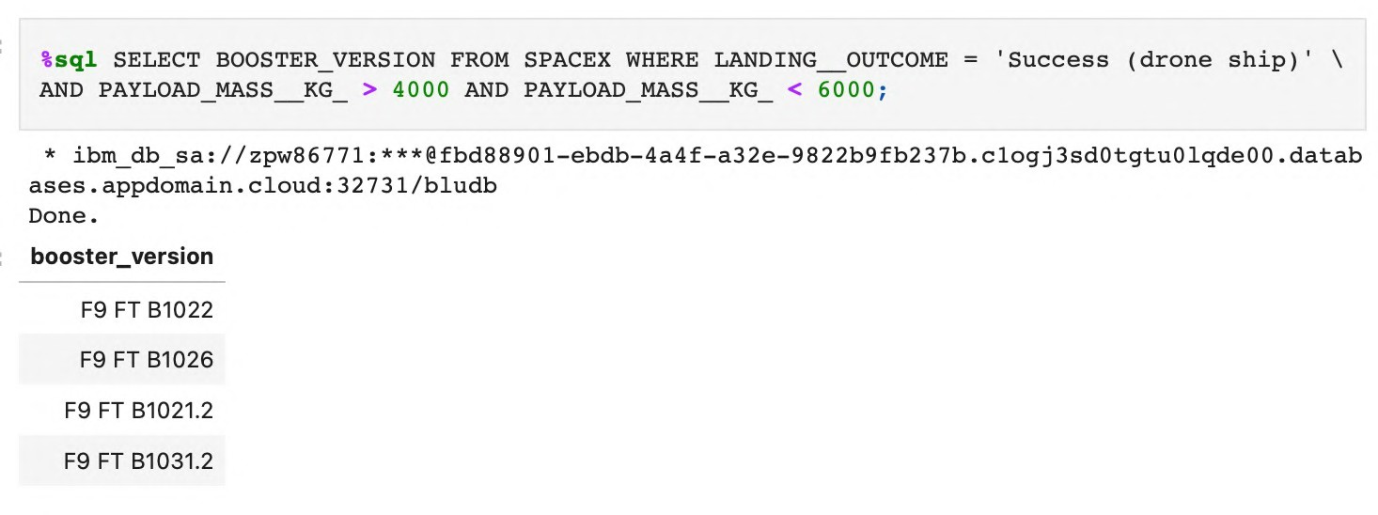
Successful Drone Ship Landing with Payload between 4000 and 6000
We used the WHERE clause to filter for boosters which have successfully landed on drone ship and applied the AND condition to determine successful landing with payload mass greater than 4000 but less than 6000

Slide 31

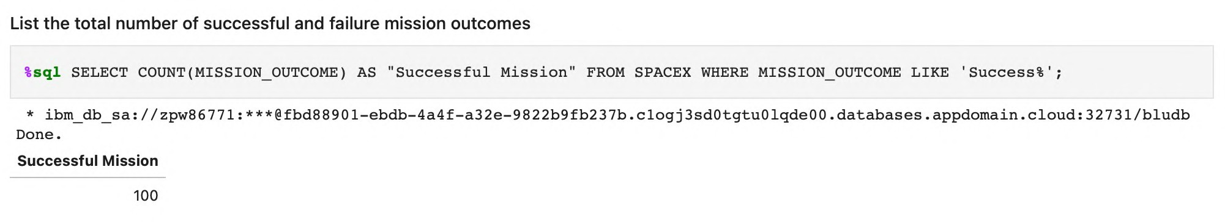

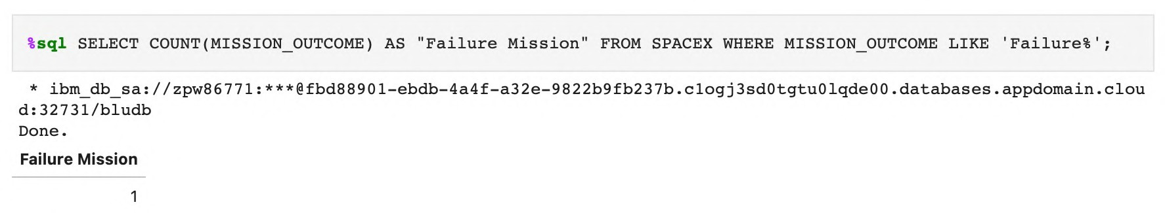
Total Number of Successful and Failure Mission Outcomes
We used wildcard like ‘%’ to filter for WHERE MissionOutcome was a success or a failure.

Slide 32

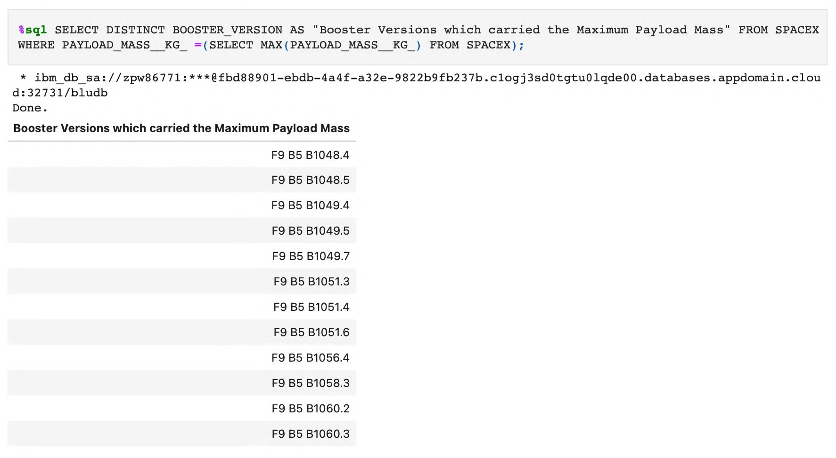
Boosters Carried Maximum Payload
We determined the booster that have carried the maximum payload using a subquery in the WHERE clause and the MAX() function.

Slide 33

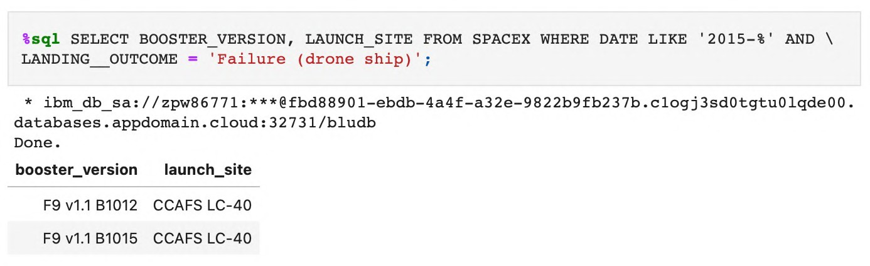
2015 Launch Records
We used a combinations of the WHERE clause, LIKE, AND, and BETWEEN conditions to filter for failed landing outcomes in drone ship, their booster versions, and launch site names for year 2015

Slide 34

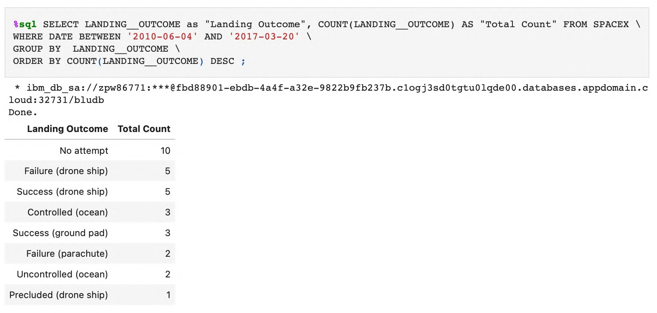
Rank Landing Outcomes Between 2010-06-04 and 2017-03-20
We selected Landing outcomes and the COUNT of landing outcomes from the data and used the WHERE clause to filter for landing outcomes BETWEEN 2010-06-04 to
2010-03-20.
We applied the GROUP BY clause to group the landing outcomes and the ORDER BY clause to order the grouped landing outcome in descending order.

Slide 35

Section 3

Slide 36

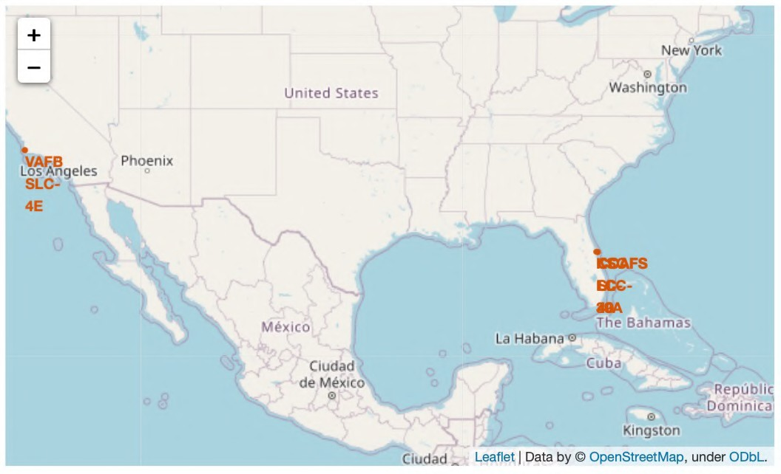
Location of all the Launch Sites
We can see that all the SpaceX launch sites are located inside the United States

Slide 37

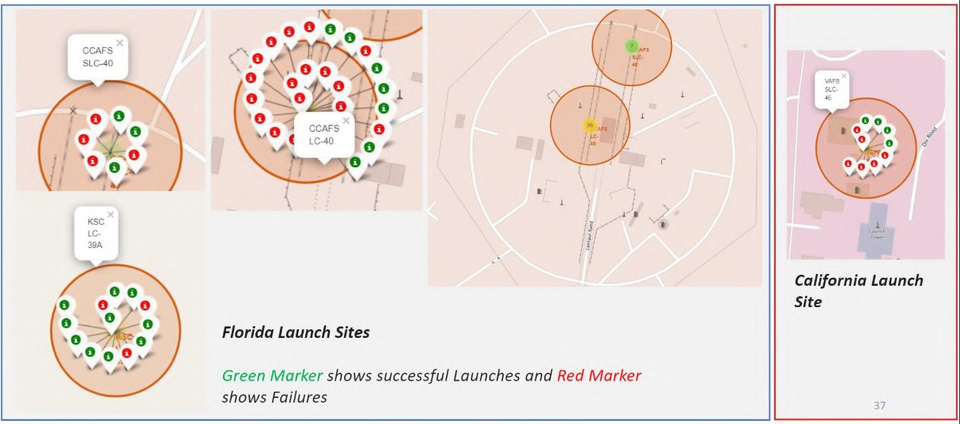
Markers showing launch sites with color labels

Slide 38




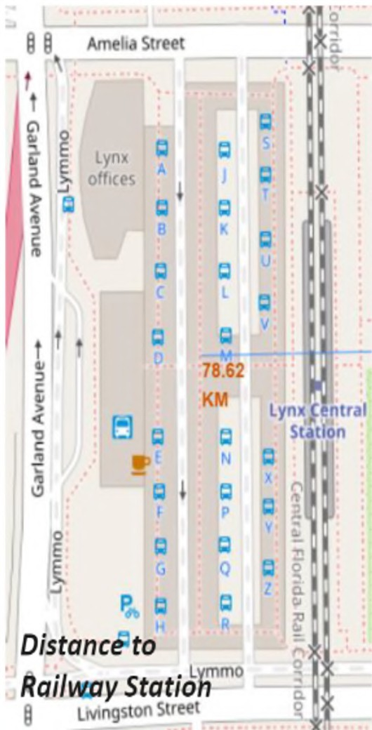
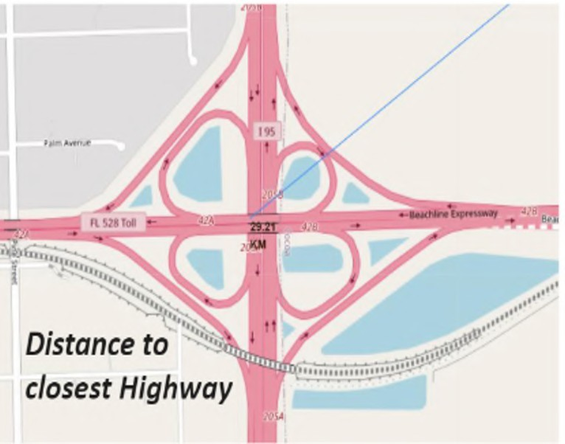
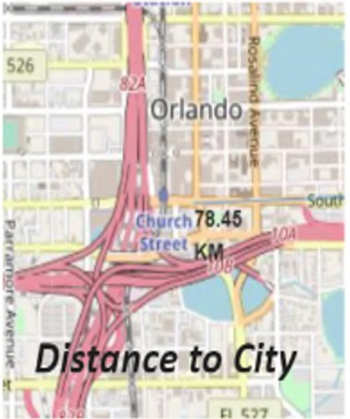
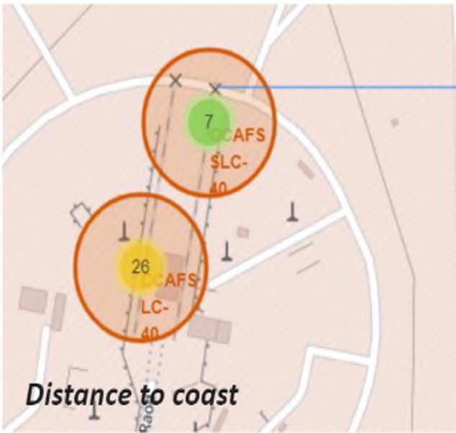


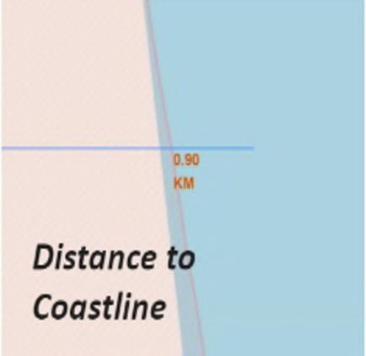
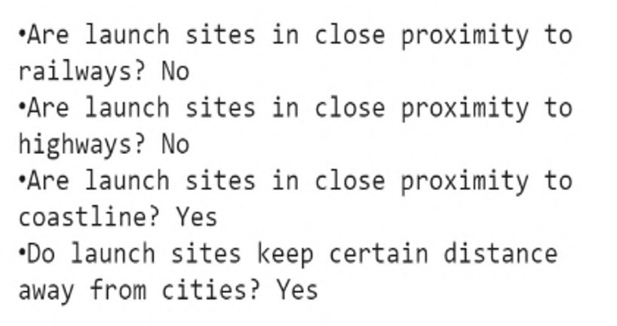
Launch Sites Distance to Landmarks

Slide 39

Section 4

Slide 40

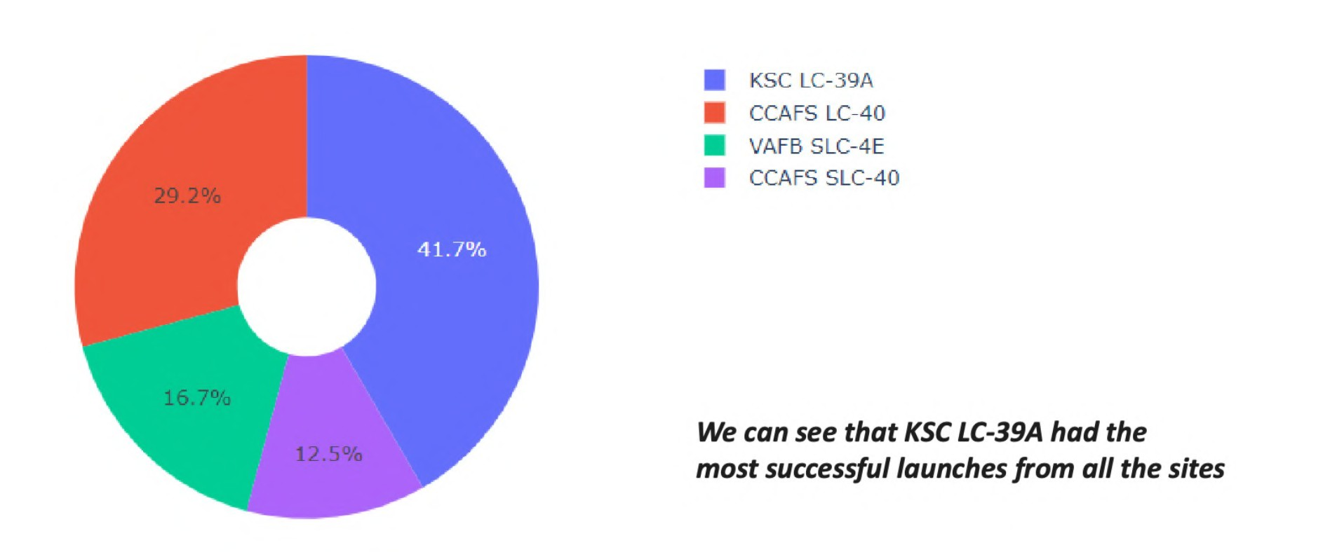
The success percentage by each sites.

Slide 41

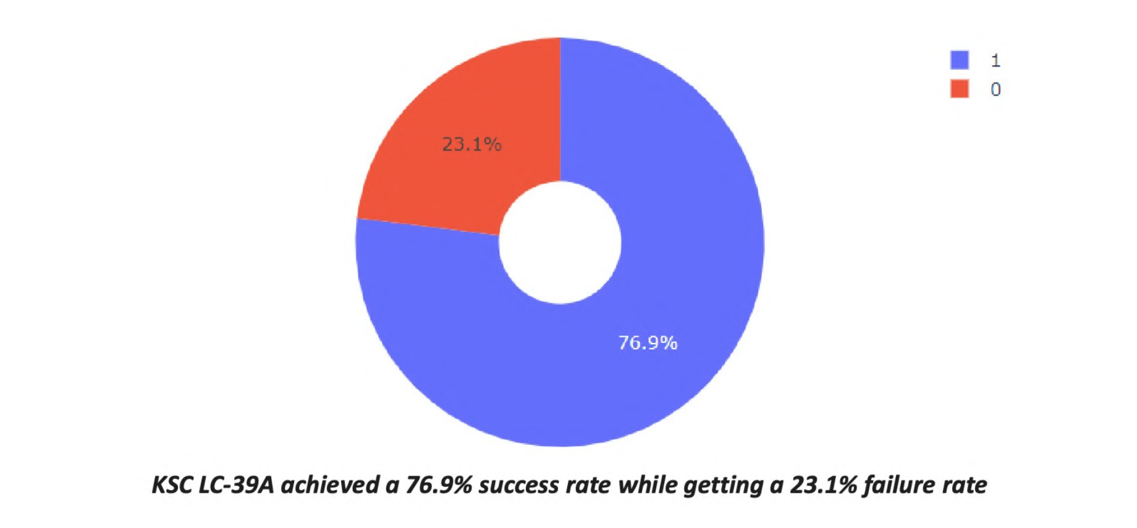
The highest launch-success ratio: KSC LC-39A

Slide 42


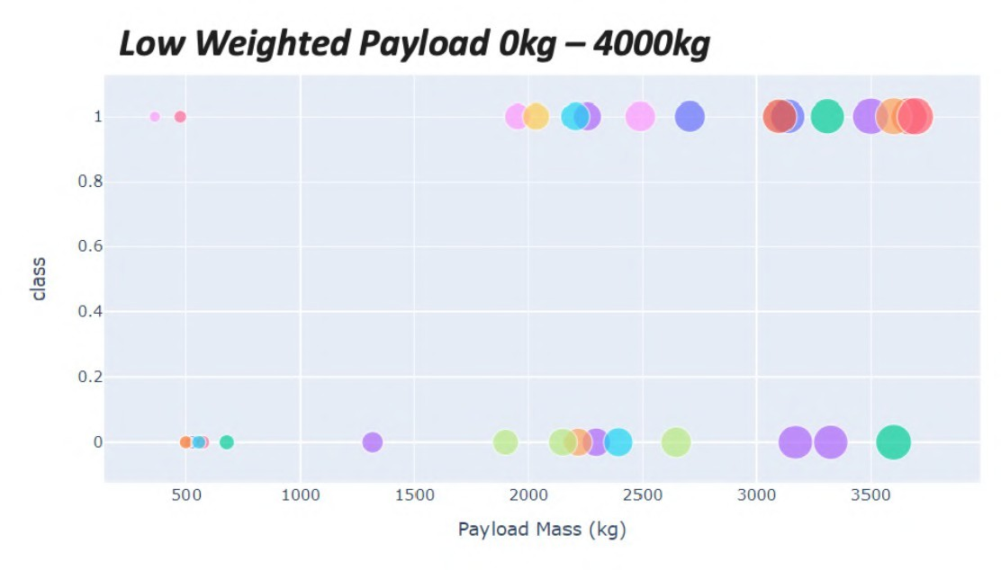
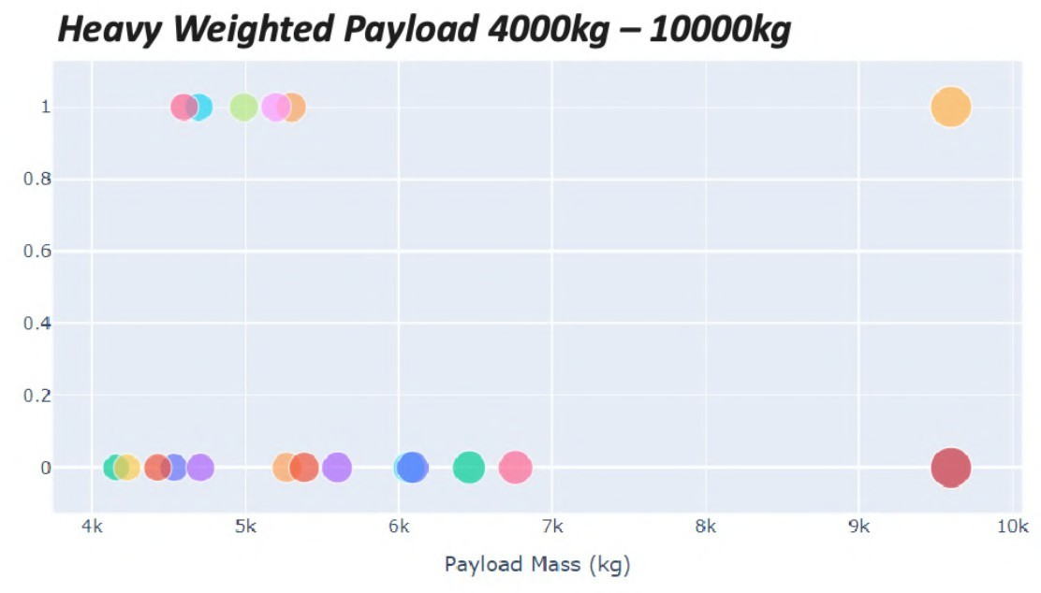
Payload vs Launch Outcome Scatter Plot
We can see that all the success rate for low weighted payload is higher than heavy weighted payload

Slide 43

Section 5

Slide 44

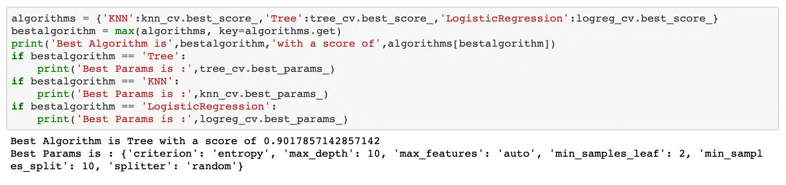
Classification Accuracy
As we can see, by using the code as below: we could identify that the best algorithm to be the Tree Algorithm which have the highest classification accuracy.

Slide 45


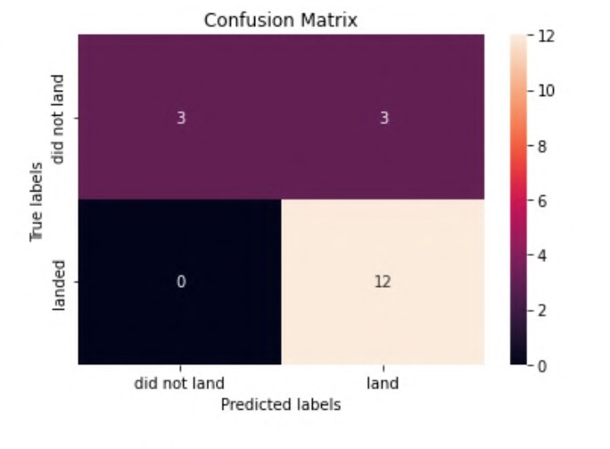
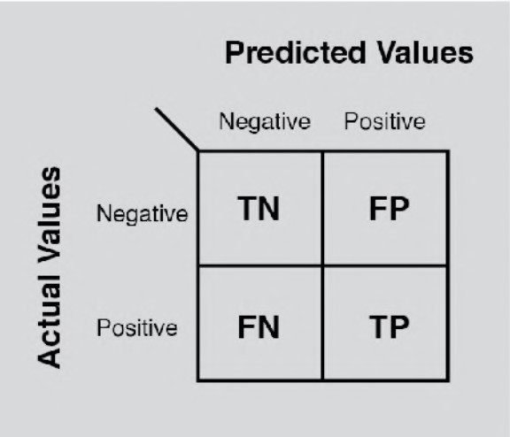
Confusion Matrix
The confusion matrix for the decision tree classifier shows that the classifier can distinguish between the different classes. The major problem is the false positives
.i.e., unsuccessful landing marked as successful landing by the classifier.

Slide 46
Conclusions
We can conclude that:
The Tree Classifier Algorithm is the best Machine Learning approach for this dataset.
The low weighted payloads (which define as 4000kg and below) performed better than the heavy weighted payloads.
Starting from the year 2013, the success rate for SpaceX launches is increased, directly proportional time in years to 2020, which it will eventually perfect the launches in the future.
KSC LC-39A have the most successful launches of any sites; 76.9%
SSO orbit have the most success rate; 100% and more than 1 occurrence.

Slide 47





,,..
Ԅ
....

